Slide 1
HTML 5 - Training

Slide 2
What is Meta tag
The <meta> Element
The <meta> element is typically used to specify the character set, page description, keywords, author of the document, and viewport settings.
Define the character set used:
<meta charset="UTF-8">
Define a description of your web page:
<meta name="description" content=“Web Development Training">
Define the author of a page:
<meta name="author" content=“Amol">
Setting the viewport to make your website look good on all devices:
<meta name="viewport" content="width=device-width, initial-scale=1.0">

Slide 3


Open graph

Slide 4
Main Categories of Elements and Attributes
The main categories of elements are mentioned below:
Block level elements :
<div>, <p>, <h1> to <h6>, <form>, <table> etc.,
Inline elements :
<img>, <a>, <span>, <input> etc.,
Attributes:
Attributes are something which give the additional information of the element.
Ex. name, width, height, alt, title, href, id, class, etc.,

Slide 5
HTML Block and Inline Elements
Every HTML element has a default display value, depending on what type of element it is.
There are two display values: block and inline.
Block-level Elements:
A block-level element always begins a new line on a web page.
It extends the full width of the available horizontal space of its parent element.
A block level element has a top and a bottom margin, whereas an inline element does not.
Eg: <div></div>

Slide 6
HTML Block and Inline Elements continue..
Inline Elements
An inline element does not start on a new line.
An inline element only takes up as much width as necessary.
Eg: <span></span>
Note: An inline element cannot contain a block-level element!

Slide 7
HTML Elements continue..
HTML <div> Tag
The <div> tag defines a division or a section in an HTML document.
The <div> element is often used as a container for other HTML elements
HTML <span> Tag
The <span> tag is used to group inline-elements in a document.
The <span> tag provides no visual change by itself.
The <span> tag provides a way to add a hook to a part of a text or a part of a document
<div style="background-color:lightblue"> <h3>This is a heading</h3> <p>This is a paragraph.</p> </div>
<p>My mother has <span style="color:blue">blue</span> eyes.</p>

Slide 8
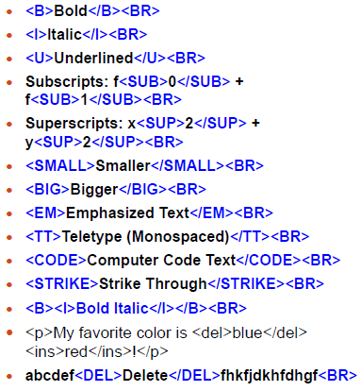
USEFULL TAGS

Slide 9
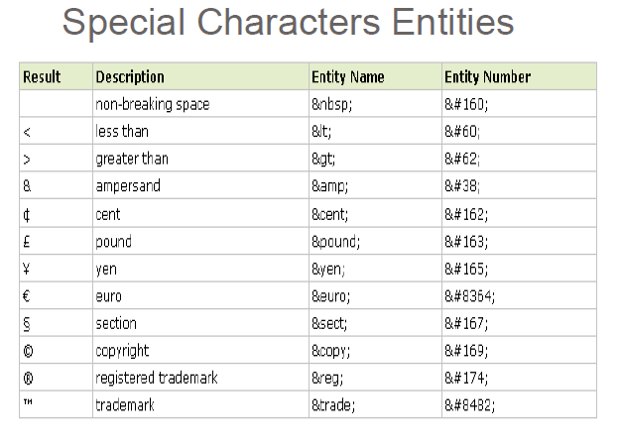

Slide 10
Empty HTML Elements
HTML elements with no content are called empty elements.
Line Break Tag
<br> is an empty element without a closing tag (the <br> tag defines a line break).
<p>This is a <br /> paragraph with a line break.</p>
Horizontal Lines
Horizontal lines are used to visually break-up sections of a document.
<p>This is paragraph one and should be on top</p>
<hr />
<p>This is paragraph two and should be at bottom</p>

Slide 11
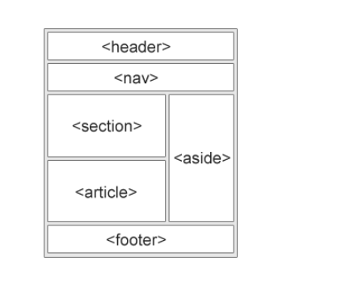
Semantic elements

Slide 12
HTML Elements continue..
HTML Lists
HTML lists are defined with the <ul> (unordered/bullet list) or the <ol> (ordered/numbered list) tag, followed by <li> tags (list items):
<ul> <li>Coffee</li> <li>Tea</li> <li>Milk</li> </ul>
<ol> <li>Coffee</li> <li>Tea</li> <li>Milk</li> </ol>

Slide 13
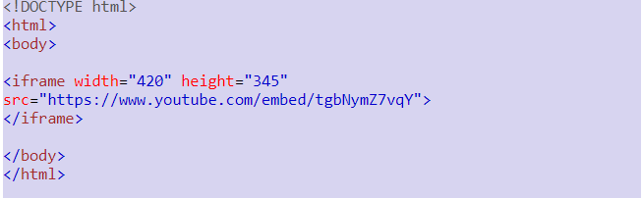
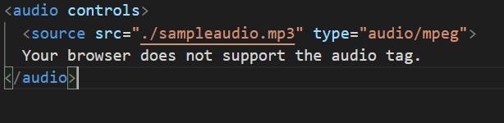
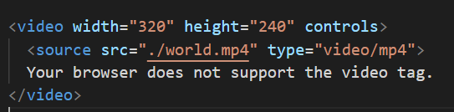
Media tag

